Slide 1
WRITING THE RESEARCH PLAN
Based on O’Leary, Z. (2010) The essential guide to doing your research project

Slide 2
Elements of the research plan
Title
Abstract or summary
Background, context or rationale
Aims and objectives
Hypothesis
Literature review
Research design and methods
Ethical issues
Project timetable
Deliverables, outputs and outcomes
Risk assessment
Resources and costs
Project evaluation
References
Appendices

Slide 3
1. Title
The title of your project should be clear and accurate. Try to make it short and memorable, but not at the expense of clarity.
E.g.: An investigation into the use of reading lists as a pedagogical tool to support the development of information skills amongst Foundation Degree students.

Slide 4
2. Abstract or summary
The abstract is an overview of the proposed project/paper. It is one of the first things that your audience will read. It should include the rationale for the work, its main objectives and the methods to be used for achieving these.
Abstract - резюме
Overview - обзор
Audience - аудитория
Rationale - обоснование
Objectives - задачи

Slide 5
3. Background, context or rationale
In this section you should describe why you wish to conduct the project, and why it is relevant, important and timely. This section offers justification for the proposed work; it also demonstrates that you are aware of current developments in your field.
Relevant - актуальный
Timely - своевременный
Justification - обоснование
Current developments - текущие события

Slide 6
4. Aims and objectives
There should be a clear connection between the research question and the aims and objectives.
The aim of a research project is usually general, while the objectives are more specific or focused questions that will address different aspects of the aim.
In a project management context it is often stated that objectives should be ‘SMART’
Specific - конкретный
Measurable - измеримый
Achievable - достижимый
Relevant (or realistic) - соответствующий
Time-bound – привязанный ко времени

Slide 7
5. Hypothesis
For a more ‘scientific’ or experimental approach, the researcher may choose to generate and test a hypothesis. A hypothesis is a statement of expected behavior.
Approach – подход, метод
Generate – выработать
Test – проверить
Statement – констатация
Behavior – поведение, свойства

Slide 8
6. Literature review
Literature may comprise not only scholarly papers; but also national, local or organizational policy documents.
You should be familiar with the key issues and theories from your subject area and be able to identify any gaps.
You will also have established that your proposed area of research has not in fact already been covered by another researcher.

Slide 9
7. Research design and methods
This section is the heart of your research plan. Its purpose is to describe how you will answer the research question and achieve the project’s aims and objectives.
It should cover the following:
The overall approach to the research.
Choice of research method, technique and tools.
Scope and boundaries.
Sampling.
Research data management.

Slide 10
8. Ethical issues
You should describe the main ethical issues (involving either people or animals) likely to arise from your project and indicate how you intend to handle these.

Slide 11
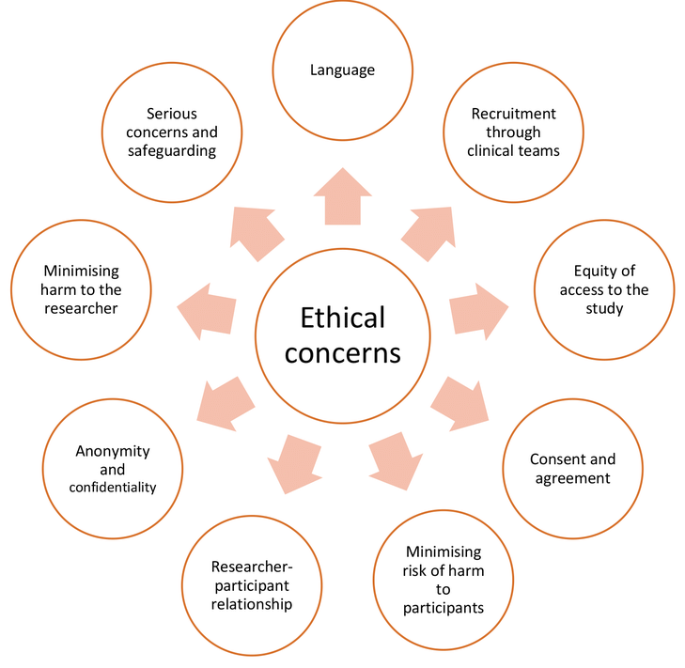

Slide 12
9. Project timetable
Your research project need to be pinned down to a realistic and achievable timescale. You need to work out how long each part of the project is likely to take. It can be helpful to present the project timeline in diagrammatic form, for example using a Gantt chart.
pinned down – привязанный
timescale – шкала времени
likely to take – предположительно займет

Slide 13
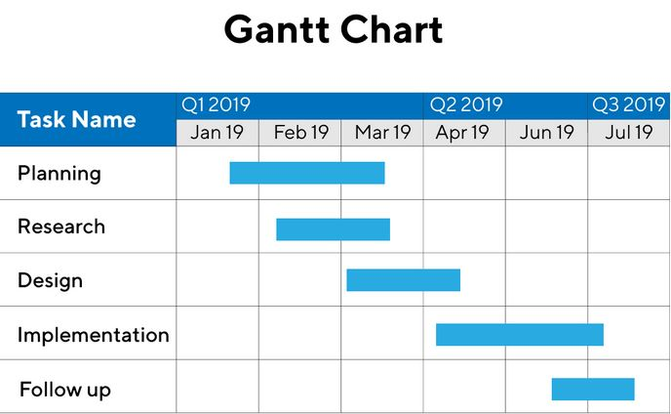

Slide 14
10. Deliverables, outputs and outcomes
Your project deliverables represent its impact on your institution, academia and society. Outputs are the things you will produce as part of your project and are tangible and measurable. Outcomes are the results or consequences of the project.
Deliverables –выдаваемые данные, impact - влияние
Outputs - произведённая продукция, выходные данные
Outcomes – результаты, consequences - последствия

Slide 15
11. Risk assessment
Every project contains an element of risk.
You have four main options in managing risk:
1. Accept the consequences of the risk. – принять последствия
2. Transfer the risk. – перенести на др. фактор
3. Avoid the risk. - избежать
4. Reduce the risk. - уменьшить

Slide 16
12. Resources and costs
The resources required for a project can range from one researcher with a PC to a multinational research team and a wide range of expensive equipment.

Slide 17
13. Project evaluation
How will you know that your research project has been a success?
Define formal success criteria in terms of the research aims and objectives.
Methods of evaluation might include feedback from stakeholders, usage statistics, peer review etc.

Slide 18
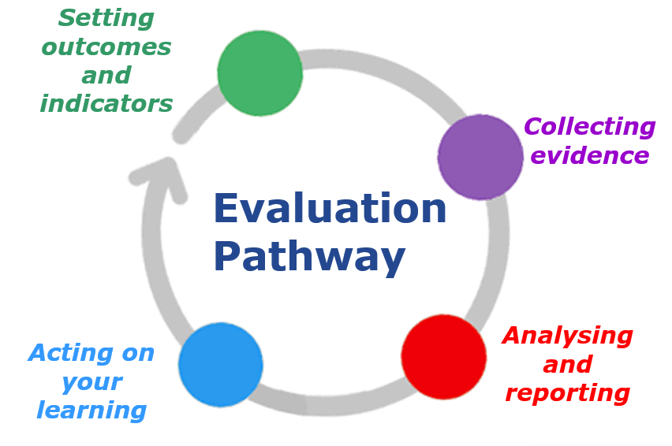

Slide 19
14. References
Any documents, websites, or other resources referred to in the proposal must be correctly referenced.

Slide 20
15. Appendices
An appendix may be used for supplementary information, for example a copy of a questionnaire or an interview schedule, or for other supporting documentation.
Appendix – приложение
Supplementary – дополнительный
questionnaire – анкета
interview schedule – расписание собеседований

